Slide 1






Presented By:
Pedestrian trajectory
prediction using pattern
Recognition and CNN
Mubtasim Fuad Mozumder
20101463

Slide 2


Introduction

Slide 3
Introduction
1. Challenging Task: Pedestrian trajectory prediction is gaining attention due to its relevance in human surveillance, autonomous driving, and socio-robot navigation.
2. Shift to Data-Driven Models: The ﬁeld has transitioned from physics-based models to data-driven deep learning models, where past trajectory information plays a crucial role.
3. Evolution of Architectures: Deep learning architectures have evolved, with sequence-to-sequence models becoming prevalent in pedestrian trajectory prediction.
4. Early Models: The Social Forces Model and physics-based approaches laid the foundation, but data-driven models like Social LSTM have gained popularity.
5. Incorporating Advanced Techniques: Recent works include Generative Adversarial Networks, Graph Neural Networks, attention mechanisms, spatial, and image information.
6. Unexplored Aspects: Data pre-processing, coordinate normalization, data augmentation, and the use of Convolutional Neural Networks (CNN) are areas where further research is needed.

Slide 4

Methods

Slide 5
Methods
Data Pre-processing and Convolutional Model
Effective data pre-processing is vital for pedestrian trajectory prediction.
Data normalization includes absolute coordinates, origin at ﬁrst or last observation points, and relative coordinates (velocities).
Data augmentation methods involve random rotation, mirroring, and adding Gaussian noise to input coordinates.
The convolutional model offers an alternative to Recurrent Neural Networks (RNN) for trajectory prediction.
It employs a novel architecture with embedding, padding, upsampling, and fully connected layers.
The 2D convolutional model outperforms other variations and recurrent baselines.
Recurrent Baselines and Social Information
Recurrent baselines, including a simple LSTM and an Encoder-Decoder model, are compared to convolutional models.
The LSTM baseline embeds one position, while the Encoder-Decoder uses an encoder and decoder for prediction.
Social information, such as nearby pedestrian occupancies, is introduced as an input.
Three techniques for incorporating social information are explored: square occupancy grid, circular occupancy map, and angular pedestrian grid.
Integration of social information enhances the model's understanding of the environment, improving prediction accuracy.

Slide 6
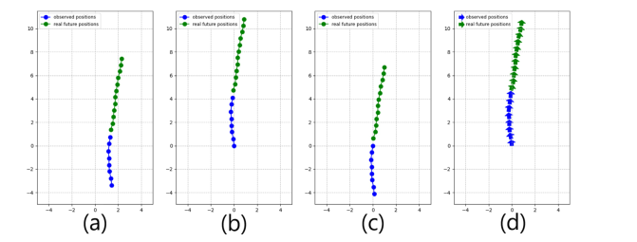
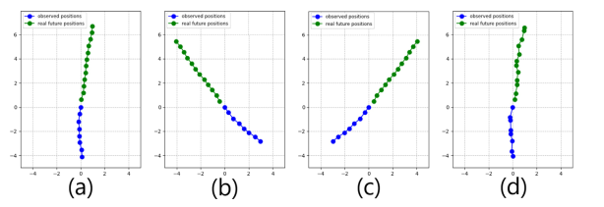
Methods
Observation and future position data readings
Both Of these figures are from 8 different pedestrian data path pattern which include observation and future path positions
<<

Slide 7

Results

Slide 8
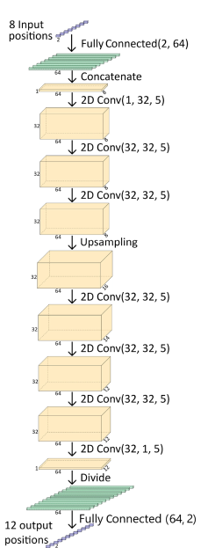
Results
Results and Pattern Recognition
Data: Utilized the ETH and UCY datasets, offering over 1600 pedestrian trajectories for analysis.
Pre-processing Techniques: Explored various data pre-processing techniques, including coordinate normalization and data augmentation.
Coordinate Normalization: Found that aligning the origin with the last observation point produced the most accurate predictions.
Data Augmentation: Employed techniques such as random rotations and Gaussian noise, enhancing prediction accuracy.
Optimal Augmentation: Random rotations combined with noise (NR) yielded the lowest prediction errors.
Applicability: Demonstrated that the data pre-processing results held true for both convolutional and recurrent models, proving their versatility.
CNN model Stucture

Slide 9
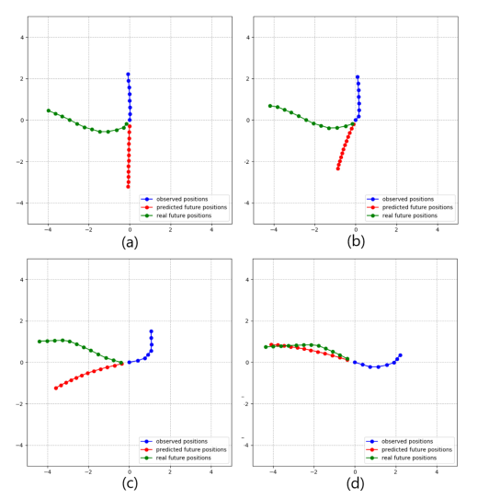
Results
Results and Model Comparison
Convolutional Models: Experimented with different convolutional model variations and recurrent baselines.
Kernel Sizes: Larger kernel sizes in convolutional models led to more reﬁned predictions.
Best Model: The 2D convolutional model consistently outperformed recurrent baselines.
Architectural Choices: Speciﬁc architectural decisions like positional embedding and residual connections had limited impact.
Social Information: The addition of social information showed minimal improvements in results.
Comparison with Literature: Compared the models with those from literature on both the ETH-UCY and TrajNet datasets, demonstrating competitive performance and highlighting the signiﬁcance of effective data augmentation techniques.
Prediction and actual path

Slide 10

Discussion

Slide 11
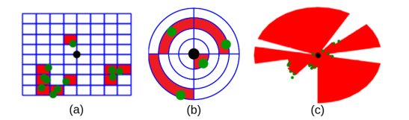
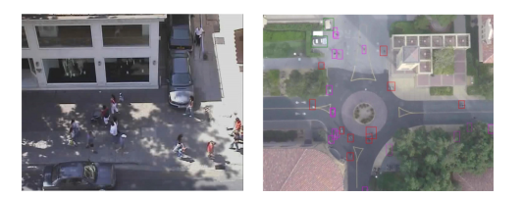
Discussion
Model Efficiency and Failure Scenarios
Efficiency: - > Convolutional model > 3x faster than LSTM baseline. - > 4x faster than Encoder-Decoder baseline. - > Advantage in training time too.
Hyperparameters: - > Recurrent models have fewer (e.g., embedding size). - > Convolutional model has more (e.g., layers, channels). - > Convolutional model requires more tuning.
Flexibility: - > Recurrent models adapt to varying input/ output lengths. - > Convolutional model needs adjustments.
Failure Scenarios: - > Key goal: Minimize maximum error. - > Convolutional model's error resembles a Gaussian curve. - > High-error scenarios: sharp turns, stopping, resuming.
Spatial Information: - > Inclusion could reduce high errors. - > Suggest exploring it in future work.
Efficient area mapping &
data distribution

Slide 12

Conclusion

Slide 13

Thank
You!

